Slide 1
Object Oriented Programming
Interaction Diagrams
(c) Copyright 2016 Dyer Consulting
Quebec, Canada
All rights reserved

Slide 2
Interaction Diagrams
Sequence Diagrams
Communication Diagrams
How to Read Communication Diagrams
Communcation Diagrams Notation
UML Message Syntax
Collections
Comparison between the two diagrams
Communication and Sequence Diagram Summary

Slide 3
Interaction Diagrams
How objects interact via messages to fulfill tasks
Dependant upon creation of artifacts
Conceptual model - from this, the designer may define software classes corresponding to concepts (Objects of these classes participate in interactions illustrated in interaction diagrams)

Slide 4
Interaction Diagrams…
Use Case Scenarios - from this the designer identifies classes, responsibilities, and post-conditions that the interaction diagrams must fulfill.
The Use case flow of events is captured in text
The Scenarios are captured in interaction diagrams

Slide 5
Interaction Diagrams …
An interaction diagram illustrates the message interactions between instances (and classes) in the class model
UML defines two types of interaction diagrams: sequence diagrams and communcation diagrams
Each is a graphical view of the scenario

Slide 6
Sequence Diagram
Add Course Offering

Slide 7
Sequence Diagrams
Show object interactions arranged in time sequence
Depicts the objects and classes involved in the scenario and the sequence of messages exchanged between the objects needed to carry out the functionality of the scenario
Objects are drawn as rectangles containing the name of the object underlined

Slide 8
Sequence Diagrams …
The object can be named in one of three ways: the object name, the object name and its class, or just the class name (anonymous object)
Vertical dashed line is called the object's lifeline
Conditions which indicates when a message is sent is enclosed in square brackets [ ]

Slide 9
Sequence Diagrams …
Lines between two lifelines represent the message being sent (indicated by a closed arrow head)
An "*" indicates an iteration (as thru a collection)
An open arrow head indicates a return message (arrow head is not open)
"self-delegation", a message that an object sends to itself (message line returning to itself)

Slide 10
Communication Diagrams
Shows object interactions organized around the object and their links to each other
Illustrates object interactions in a graph or network format, having exceptional expressiveness, ability to convey more contextual information, and relative spatial economy

Slide 11
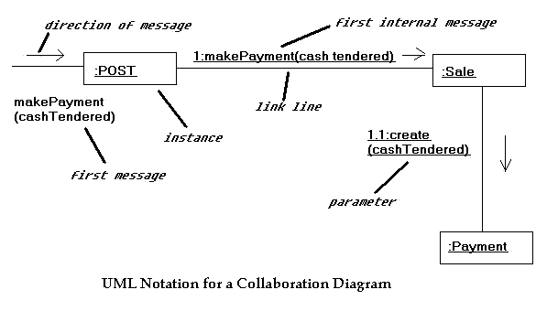

Slide 12
Communication Diagram Interpretation
1. The message makePayment is sent to an instance of Post. It corresponds to the makePayment system operation message.
2. The Post object sends the makePayment message to a Sale instance.
3. The Sale instance creates an instance of a payment

Slide 13
Communication Diagrams Terminology/Notation

Slide 14
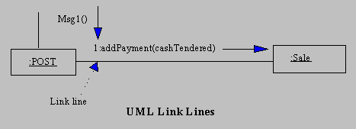
Link Line

Slide 15
Link Line
Link
A connection path between two instance
Indicates some form of navigation and visibility between the instances
An instance of an association

Slide 16
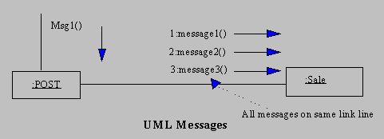
Messages

Slide 17
Messages
Messages between objects are represented via a labeled arrow on a link line
Any number of messages may flow along this link
A sequence number is added to show the sequential order of the messages

Slide 18
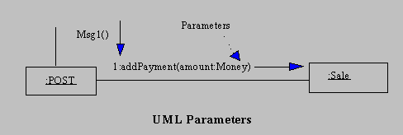
Parameters

Slide 19
Parameters
Parameters of a message may be shown within parentheses following the message name

Slide 20
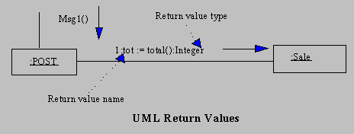
Return values

Slide 21
Return Values
Shown by preceding the message with a return value variable name and an assignment operation (':=')
Type of return value may be optionally shown

Slide 22
UML Message Syntax
return := message(parameter : parameterType):returnType
(May express messages in different syntax to reflect specific language "java")

Slide 23
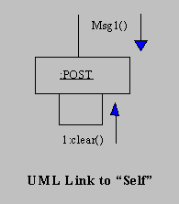
Message to "Self" or "this"
Illustrated by a link to itself, with messages flowing along the link

Slide 24
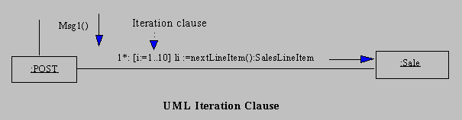
Iteration
Indicated by following the sequence number with a start "*"

Slide 25
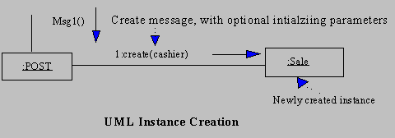
Creation of Instances
Creation message is create show being sent to the instance being created
May include parameters indicating the passing of initial values

Slide 26
Message number sequencing
The first message is not numbered
The order and nesting of subsequent messages is denoted by sequence with nested message numbers preceded with the incoming message number (see next example)

Slide 27
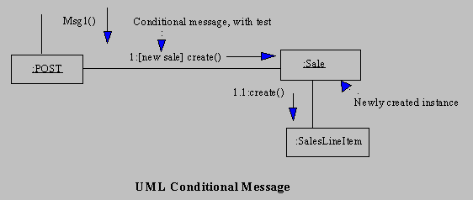
Conditional Messages
Condition is illustrated in the message line enclosed in square brackets "[condition]"

Slide 28
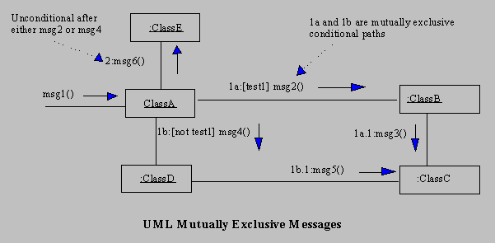
Mutually Exclusive Messages
Message number is followed by a letter (E.g. "a", "b"...), representing each possible path

Slide 29
Collections
A set of instances may be shown with a stack icon
:Sale

Slide 30
Message to Multi-objects (collections)
A message to a multi-object indicates that it is sent to the collection object itself (not each element of the collection)

Slide 31
Messages to a class object (static messages)
Message is shown to a class box whose name is not underlined
indicates the message is being sent to a class rather than an instance

Slide 32
Comparison between the two diagrams
Sequence Diagram
Shows us a time-based order - what happens first, what happens next
Useful in the early analysis phases
Communication Diagram
Provides the big picture of how the objects link to each other
Used more in the design and specification stages (implementation of relationships)

Slide 33
Interaction Diagrams
Interaction diagrams are on of the most important artifacts created in object-oriented analysis and design
The amount of time and effort spent on their generation should absorb a significant percentage of the overall project effort.

Slide 34
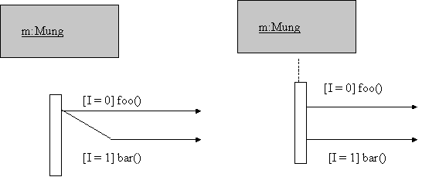
Conditional messages (guarded messages)
[I=0] foo() and [I=1] bar()

Slide 35
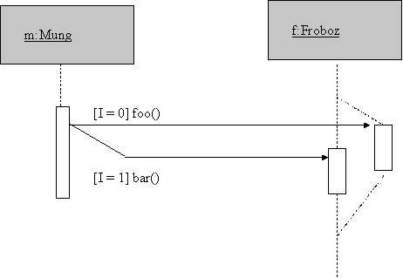
Diagram Fragment with branching life lines

Slide 36
Iteration Marker
*[1..10] prepare()

Slide 37
returns
Use for clarity ( dashed line arrow )

Slide 38
Asynchronous Messages
half-arrowheads
Does not block the caller
can carry on with its own processing
Can do one of three things
Create a new thread, in which case it links to the top of an activation
Create a new object
Communicate with a thread that is already running

Slide 39
Object Deletion
Shown with a large X

Slide 40
Activations and Computing
Objects start to compute when they receive messages
At this point an object is said to have a live activation
Eventually it may return a response to the sender of the message
May send messages to other objects to get them to compute

Slide 41
Activations and Computing …
If it sends a message, it still has a live activation, but can't do any more computing until it receives a response from the message
The message is synchronous, sending a message passes control to the receiver of the message
At any time, there may be a stack of live activations, each associated with an object which has received a message to which it has not yet replied

Slide 42
Activations and Computing …
When an object has a live activation, shown as a narrow rectangle covering its lifeline
Can optionally shade parts of the activation in while the object is actually computing
Optionally, can show when the responses to message happen (object ceases live activation)

Slide 43
Messages from an Object to Itself
When an object receives a message it gets control
Starts a new live activation of that object (gets added to the top of the stack of live activations)
In this case, object already has a live activation when it sent the message, now has a new, different activation because it's also the receiver of the message

Slide 44
Messages to Self …
Now associated with two live activations on the stack
Can be shown as an offset shaded activation rectangle slightly offset on the original activation rectangle

Slide 45
Summary
Interaction diagrams show choices in assigning responsibilities (methods) to objects
Responsibility assignment reflect what messages are sent to different classes of objects

